Slide 1
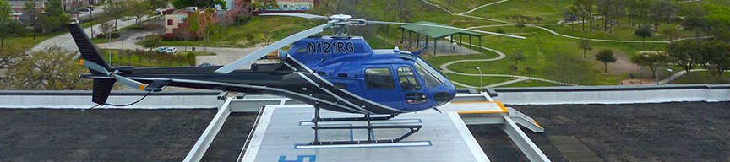


Engineered turnkey solutions
For all of your Federal and State Pipeline Requirements

Slide 2
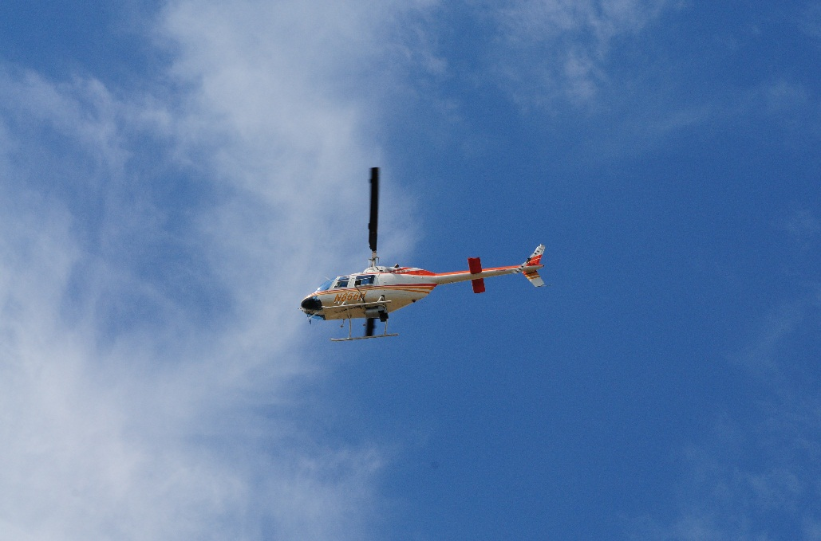
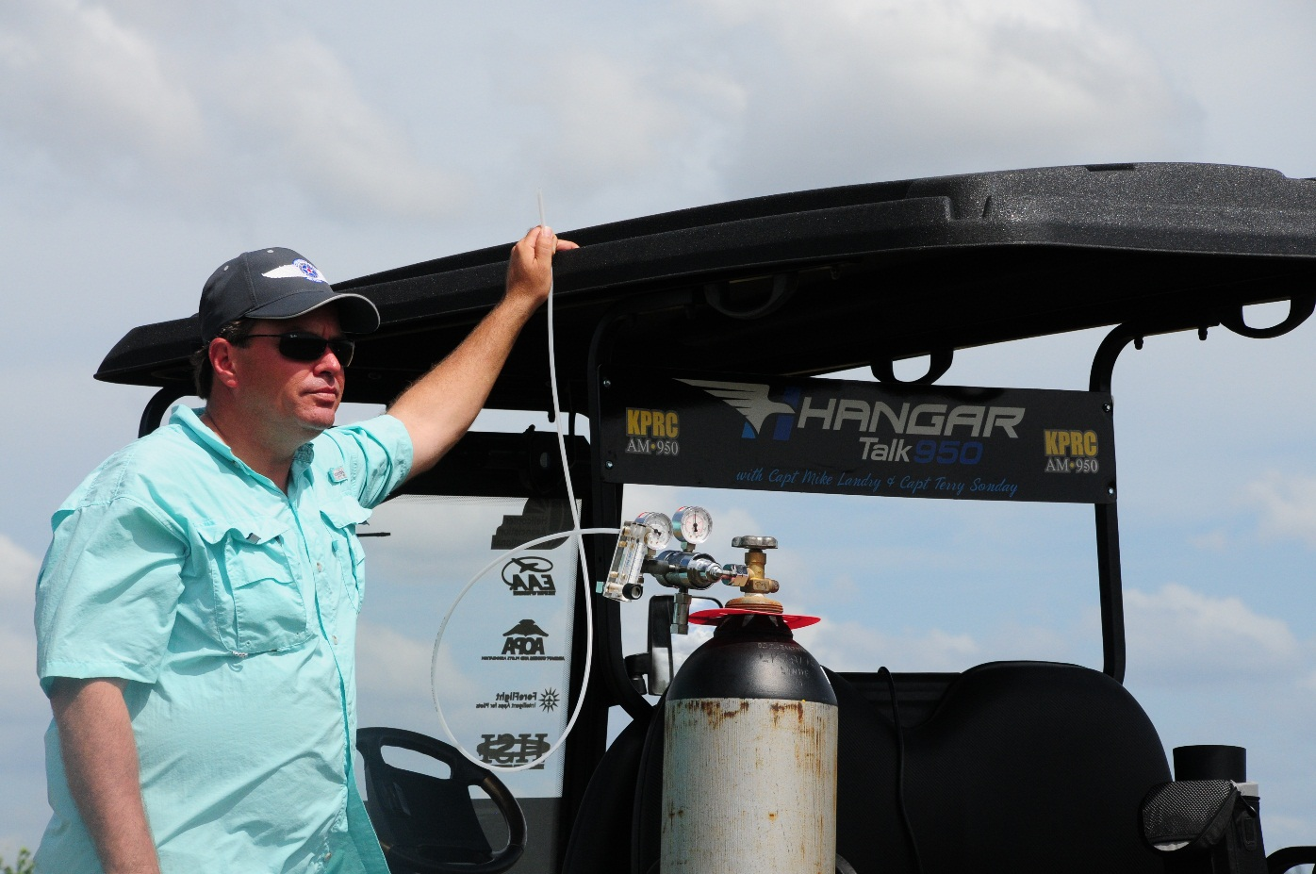
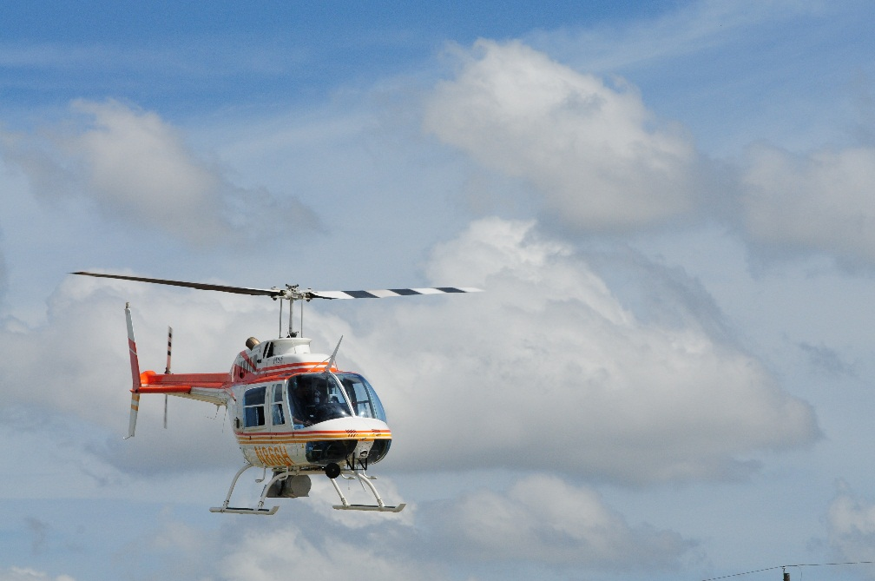
Safety Moment

Slide 3
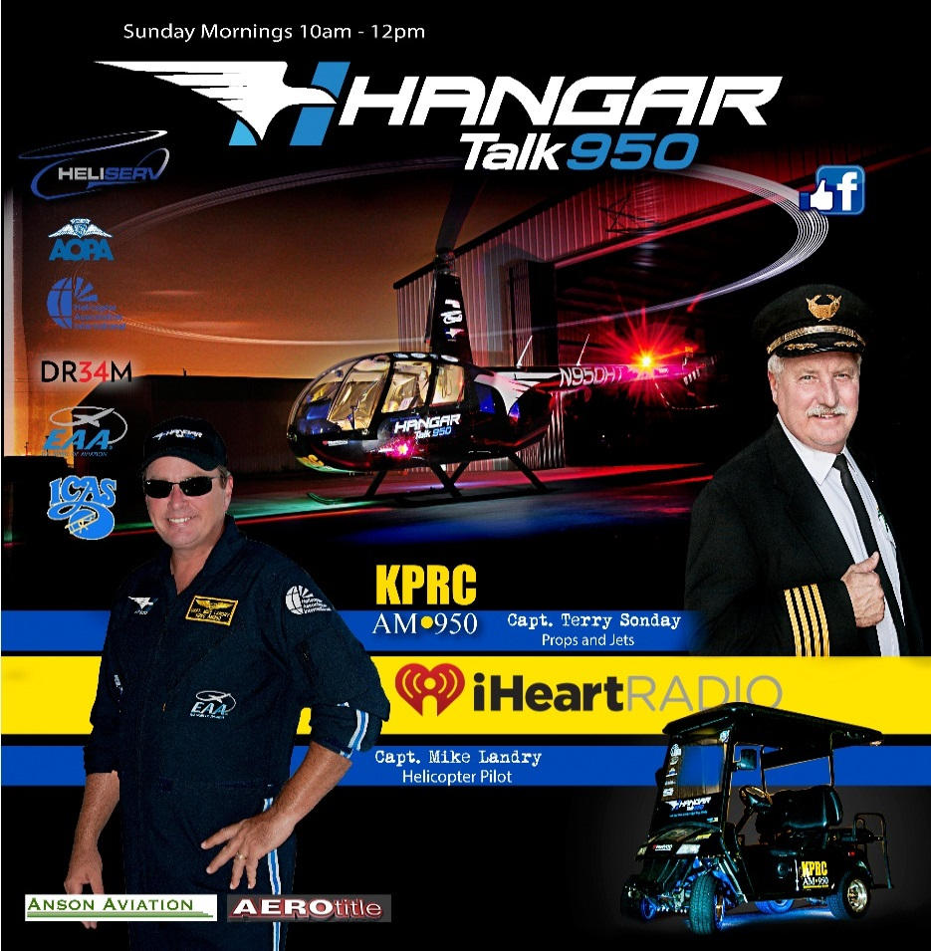
capt. Mike Landry
Host of the aviation talk show, Hangar Talk 950 KPRC

Slide 4

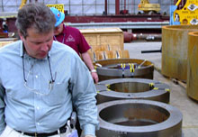

Gordon aaker, Jr., pe
Registered Professional Engineer for 32 years
Mechanical & Metallurgical Engineering Design
Authority on Pipeline Construction & Fabrication methods including Codes and Standards.
Worldwide projects with Shell, Chevron and BP
Represented both defendants and plaintiffs in multiple pipeline incidents including consulting for the DOJ environmental enforcement division.
Presently assisting the Board of Chemical Safety (CSB) in the Macondo offshore well failure.
Presented by:

Slide 5
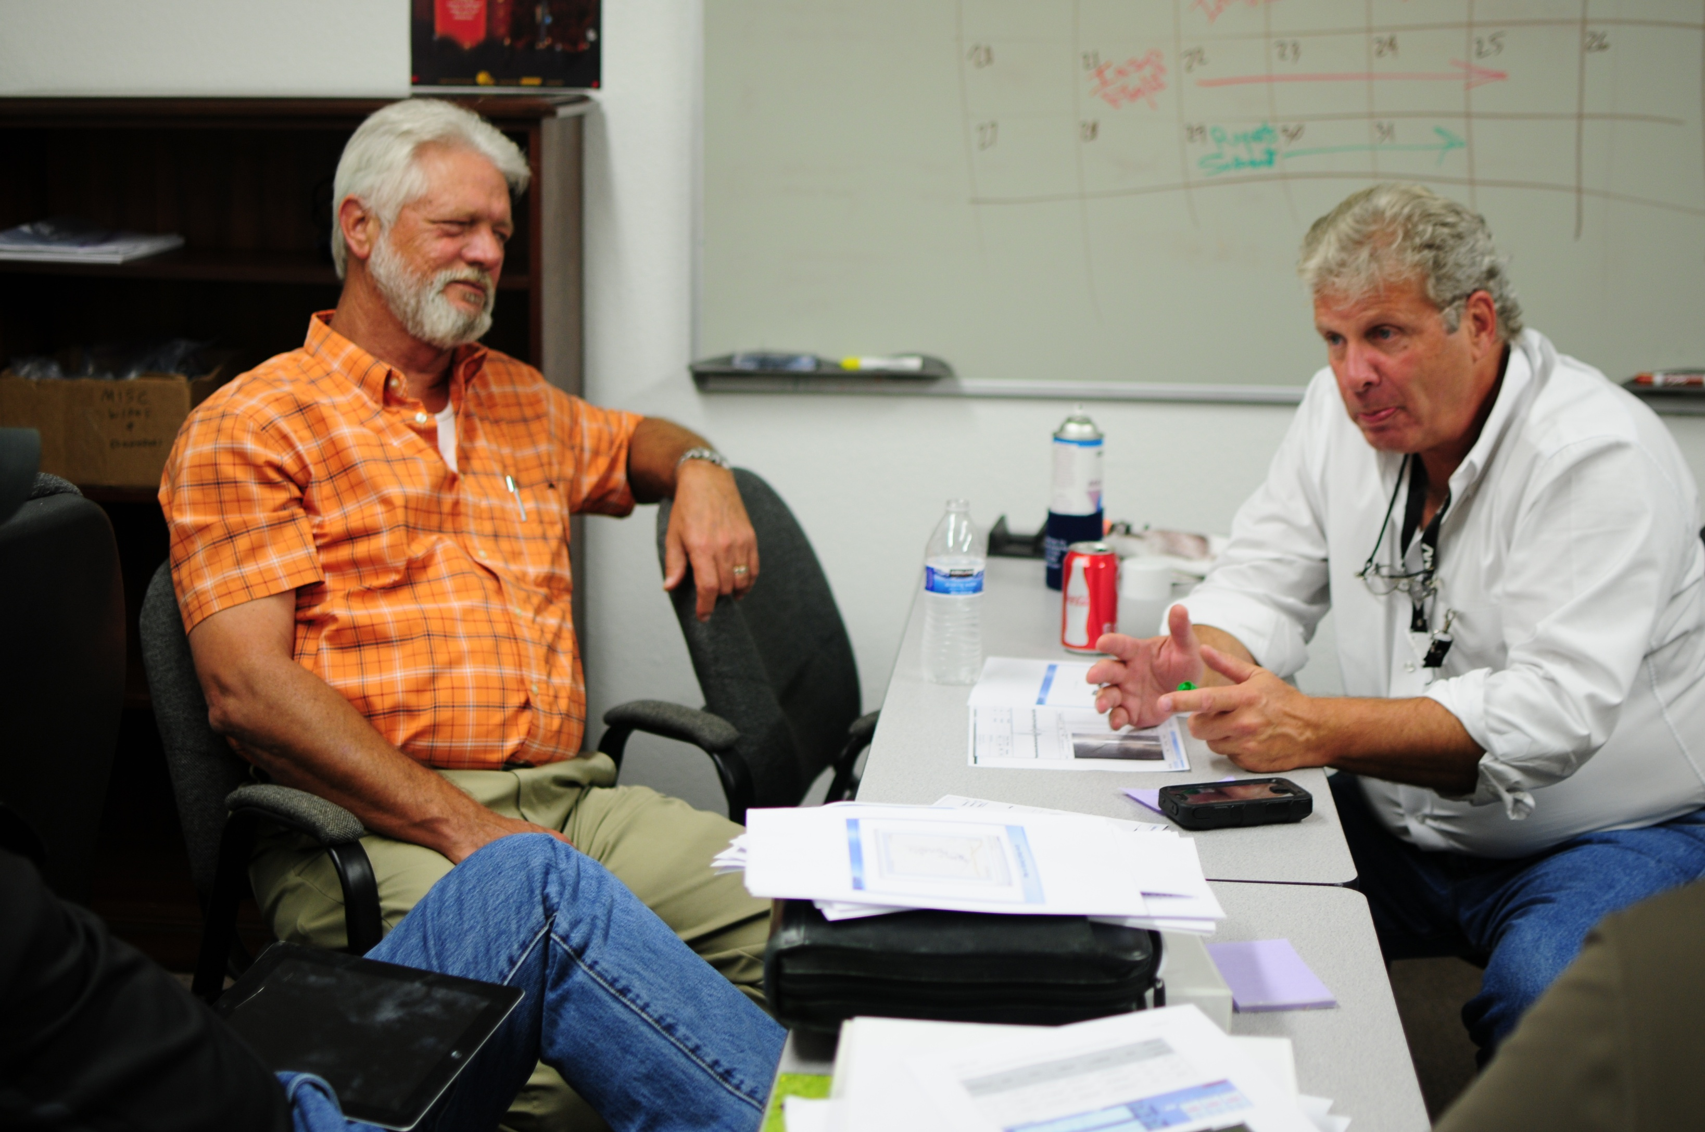
Randy Vaughn
37 years in the Pipeline Industry experience.
10 years as Integrity management and enforcement lead for liquid and gas pipelines at the RAILROAD COMMISSION OF TEXAS.
23 years project management of pipelines for SHELL Companies in Houston. As member of the technical engineering group within SHELL, performed Internal auditing .
4 years of DOT Compliance Manager for Kinder Morgan CO2
Has helped to create a safer more diligently managed set of intrastate and interstate pipelines.
Presented by:

Slide 6
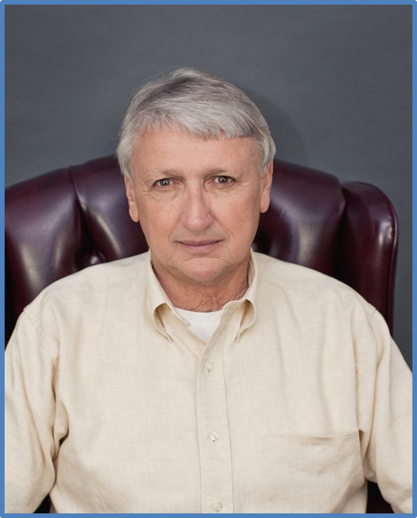
Bob Spradlin
Director of Operations /Safety Manager
Helicopter Services, Inc.
Dual Rated Pilot with over 20,000 flight hours in 45 years
Retired Army Pilot and Vietnam Vet
Retired FAA Air Traffic Control Supervisor at IAH
Thousands of flight hours for the pipeline industry both onshore & offshore.
Presented by:

Slide 7
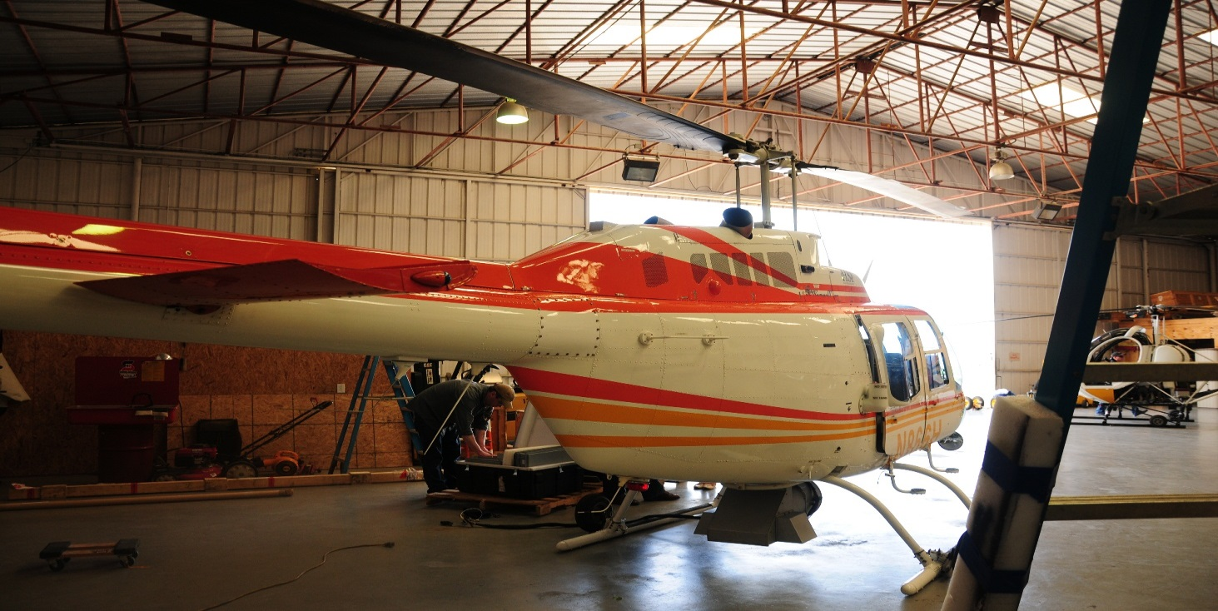
Why are we here?
Randy Vaughn

Slide 8
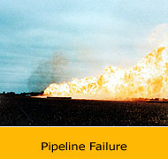
Sophisticated Process and Tasks
Help and Assists
Technical Aptitude and Short Term
Contract vendor to Supply Everything
Qualification of Personnel
Incident Occurs
The Accident Investigators Concerns

Slide 9
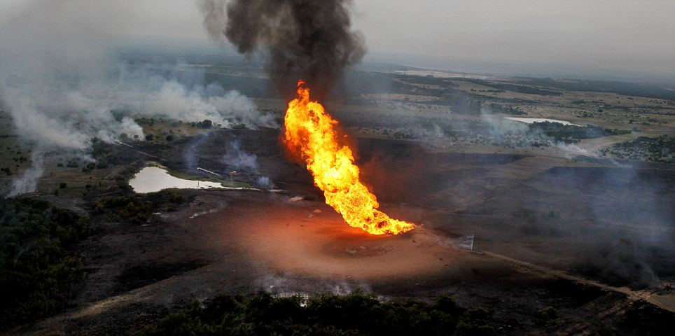
Just simple questions about data
Now the sudden realizations
Not so confident although at one time the data seemed conservative

Slide 10
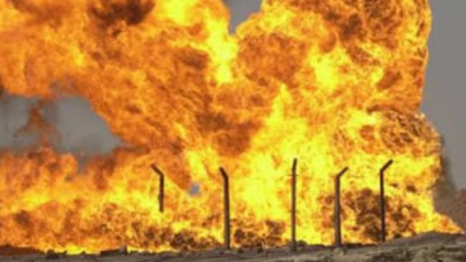
Joining of business
More forethought and history of the pipeline being looked at
Better coordination and simplification of a normal pipeliners day to day operations
Extensive testing by identifying and selecting the most reliable technology.

Slide 11
Our findings?
Gordon aaker p.e.

Slide 12

Leak Detection
The Safety Blanket You DON’T Have!

Slide 13
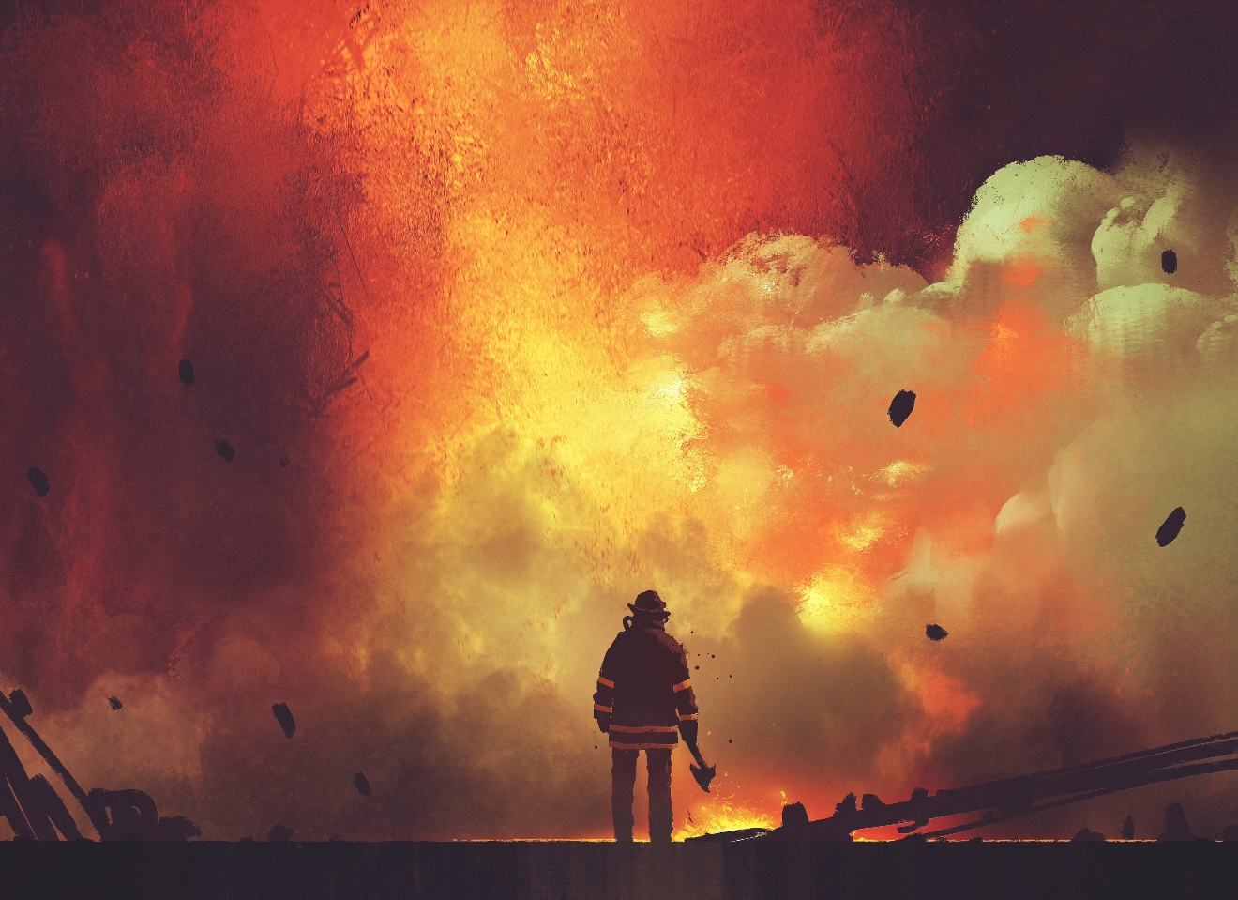
Leak Detection
The Safety Blanket You DON’T Have!

Slide 14
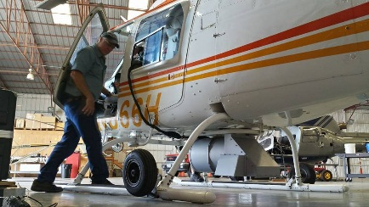
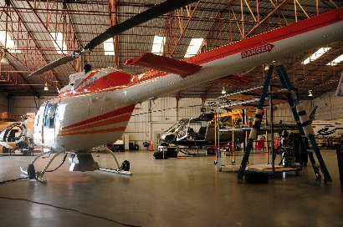
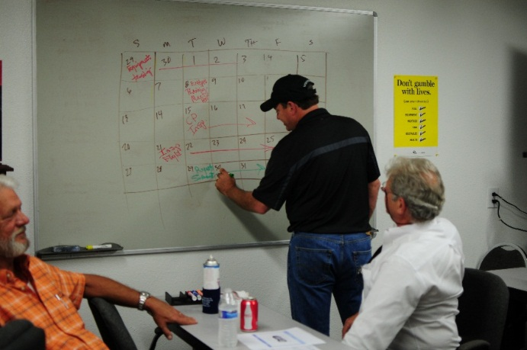
Comparing Technologies
We’ve done extensive research and testing of the multiple available platforms for leak detection.
Tunable Diode Laser
Infrared Camera
“Sniffer”

Slide 15
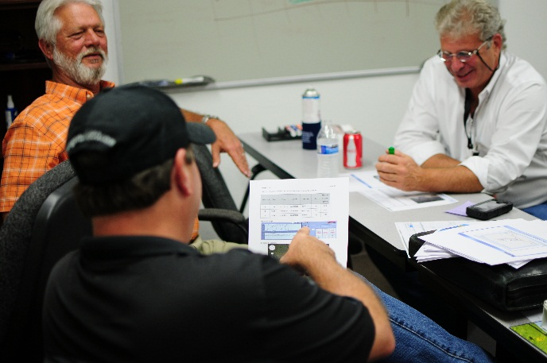
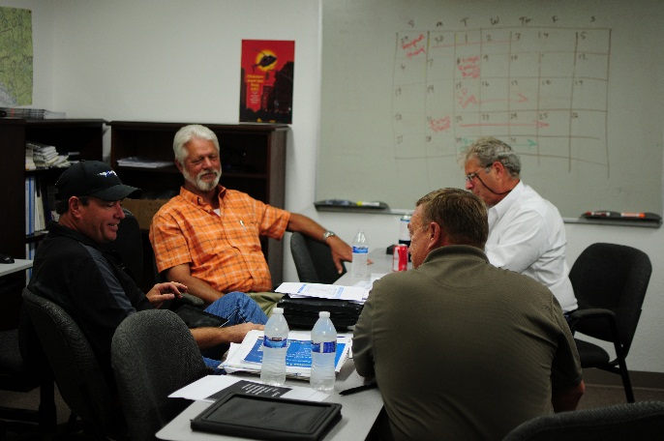
Comparing Technologies
Tunable Diode Laser
Laser is tuned to absorption wavelength of the chemical of interest (i.e. methane).
A portion of the laser energy is absorbed by the chemical it is tuned to
Laser return signal is measured to determine the amount of chemical in the atmosphere

Slide 16
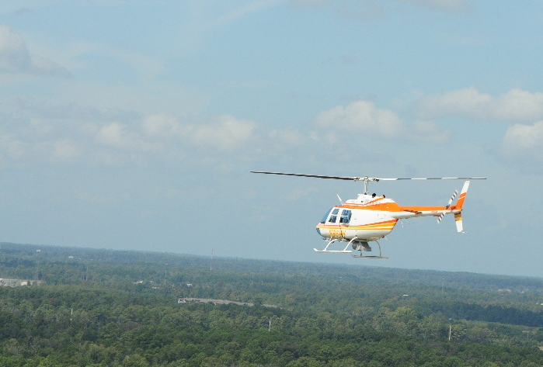
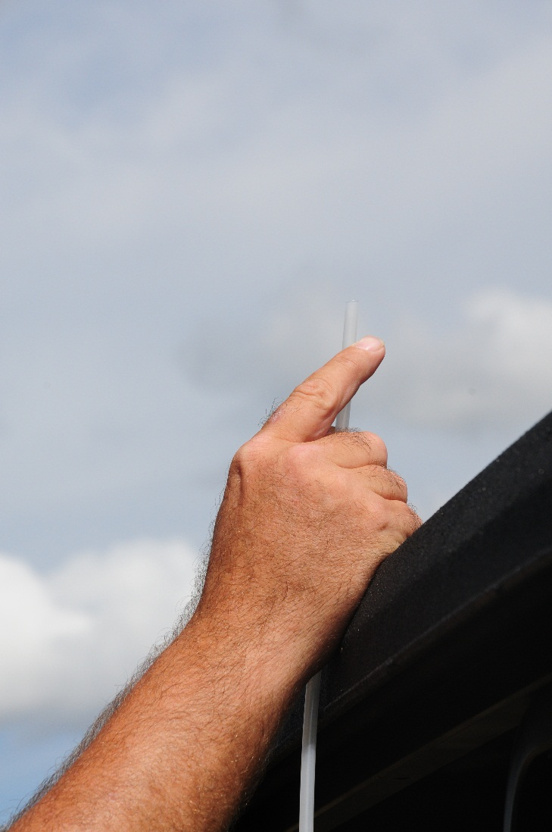
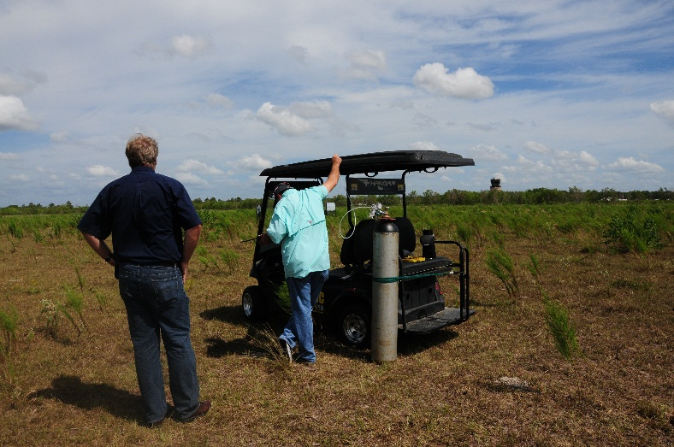
Comparing Technologies
Infrared Camera
Video camera with filter which records a select spectrum of infrared wavelengths
With these wavelengths, certain hydrocarbons absorb infrared radiation
These hydrocarbons are seen as “smoke” in video imagery

Slide 17
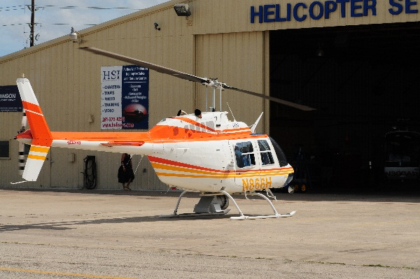
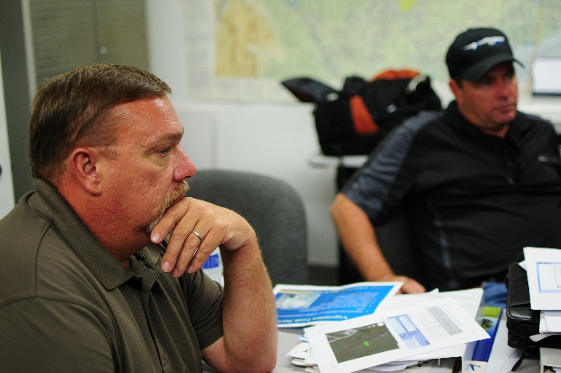
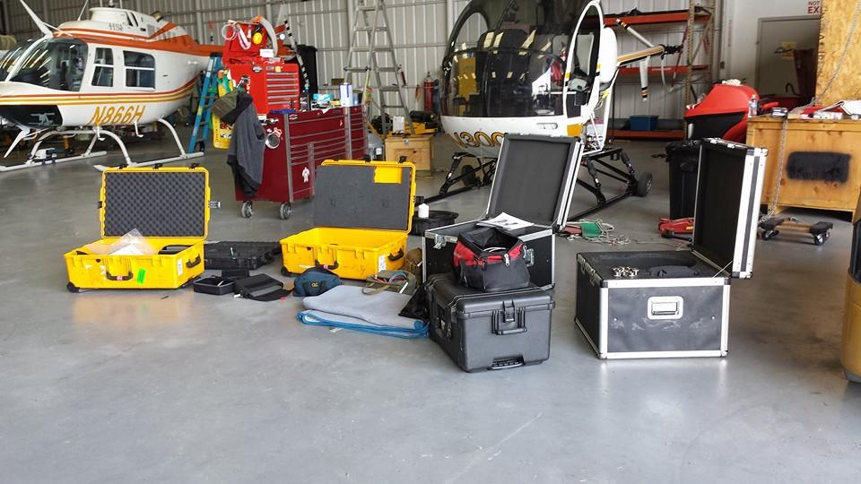
Comparing Technologies
Sniffer
Helicopter flies low to pass through a gas plume
“Sniffer” extracts a sample of air into its analyzer
Analyzer determines presence and concentration of gas present in the sample

Slide 18
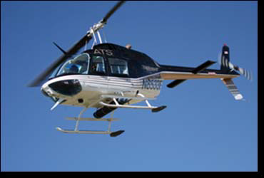
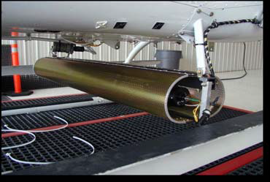
Technology 1
Tunable Laser mounted on Helicopter
Helicopter must pass through Gas plum to detect leak
REQUIRES Helicopter flies 25 to 50 feet above ground

Slide 19
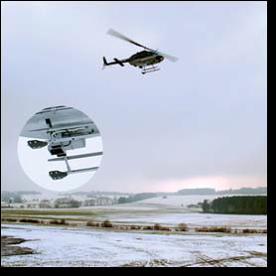
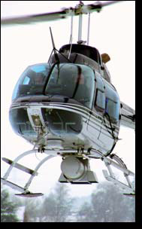
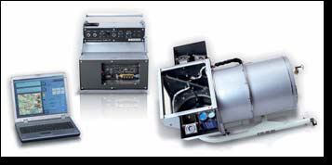
Technology 2
Tunable Laser mounted on Helicopter
Laser beam path is 8 feet wide
Successfully performed detection of methane gas from 200 to 500 feet at 60 knots

Slide 20
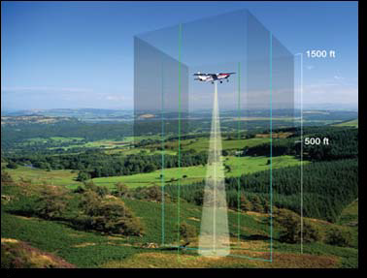
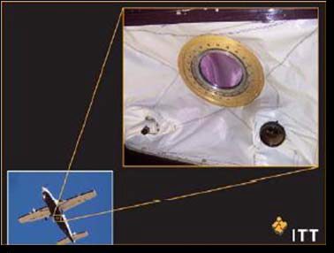
Technology 3
Tunable Laser mounted in a fixed
wing aircraft
The aircraft speed and height does not lend itself well to the performance of the system
Visiblity below a fixed winged aircraft is not possible directly over the pipeline ROW
LIMITED to flying only long straight pipelines

Slide 21
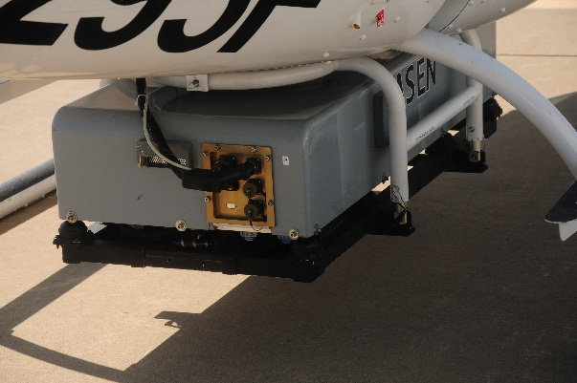
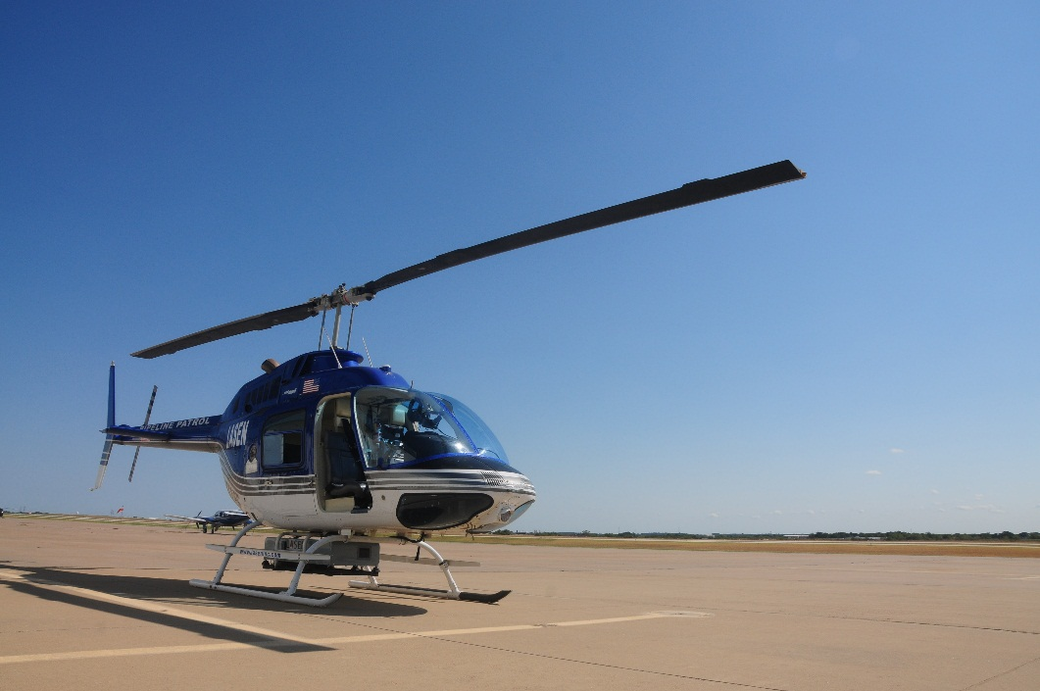
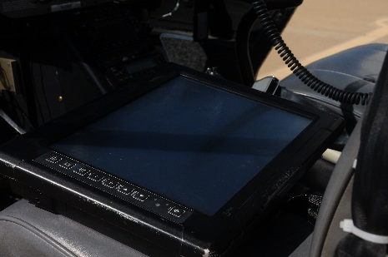
Technology 4
Tunable Laser Mounted on Helicopter
Laser Beam width is 40’
Flies 150 to 500 feet AGL (no detection was accomplished at a controlled gas release)
CLAIMS it can detect at 60mph

Slide 22
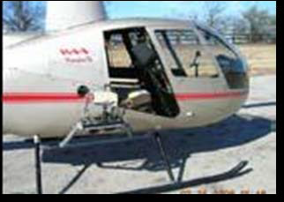
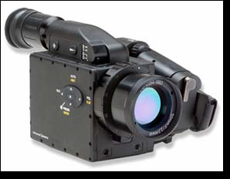
Technology 5
USED today by the TCEQ (FLIR’s Gas “FindIR” infrared camera)
This made big new back in JUNE.
Infrared camera mounts on helicopter
System relies on an operator visual indentifying gas in video imagery

Slide 23
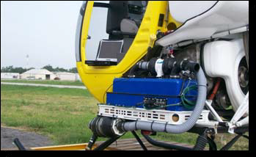
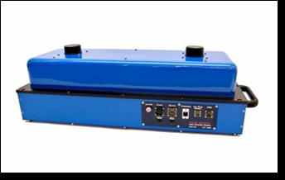
Technology 6
A helicopter mounted “sniffer” that pulls in an air sample for analysis
Helicopter flies 25 – 50’ above ground in order to pass through gas plume to detect leak.
NOT SAFE PARAMETERS FOR AIRCRAFT OPERATIONS

Slide 24

Sensitivity ?
Technology 3 – Reports 50 ppm
Technology 4 – Reports 5 ppm
Technology 5 – Reports less than 10,000 ppm
In all cases verification by the pipeline operator was relied on to establish technology effectiveness.

Slide 25
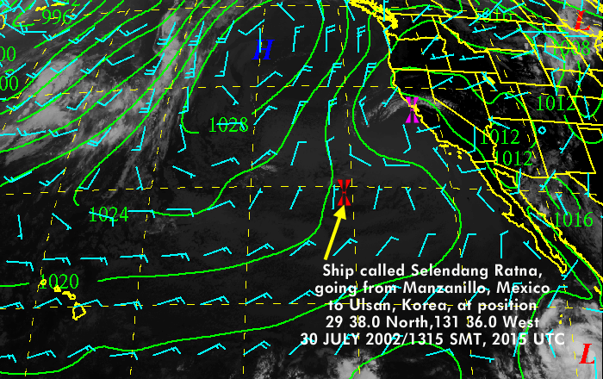

Weather Restrictions
Technology 3 claims to collect accurate data at less then 12 mph
Technology 4 claims to collect accurate data at winds up to 45 mph
High winds disperse gas quickly, which makes it harder to see with a passive system, such as an Infrared Camera

Slide 26
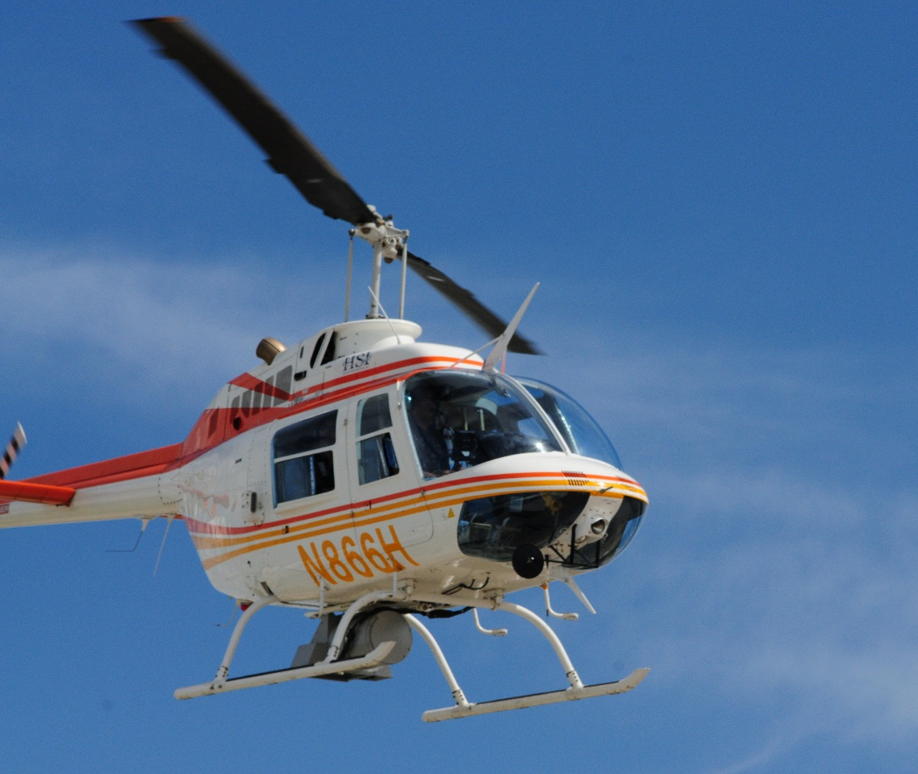
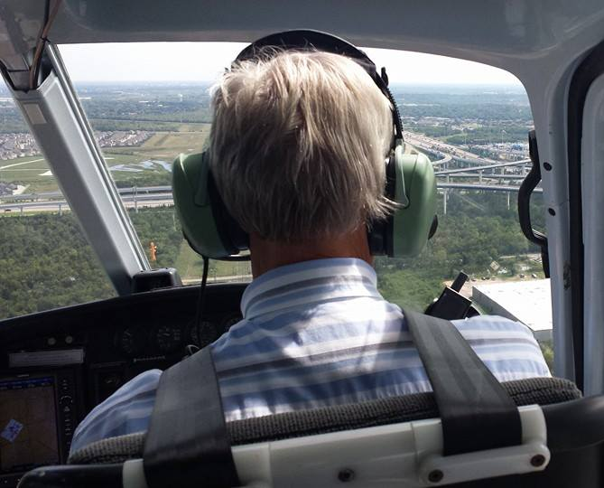
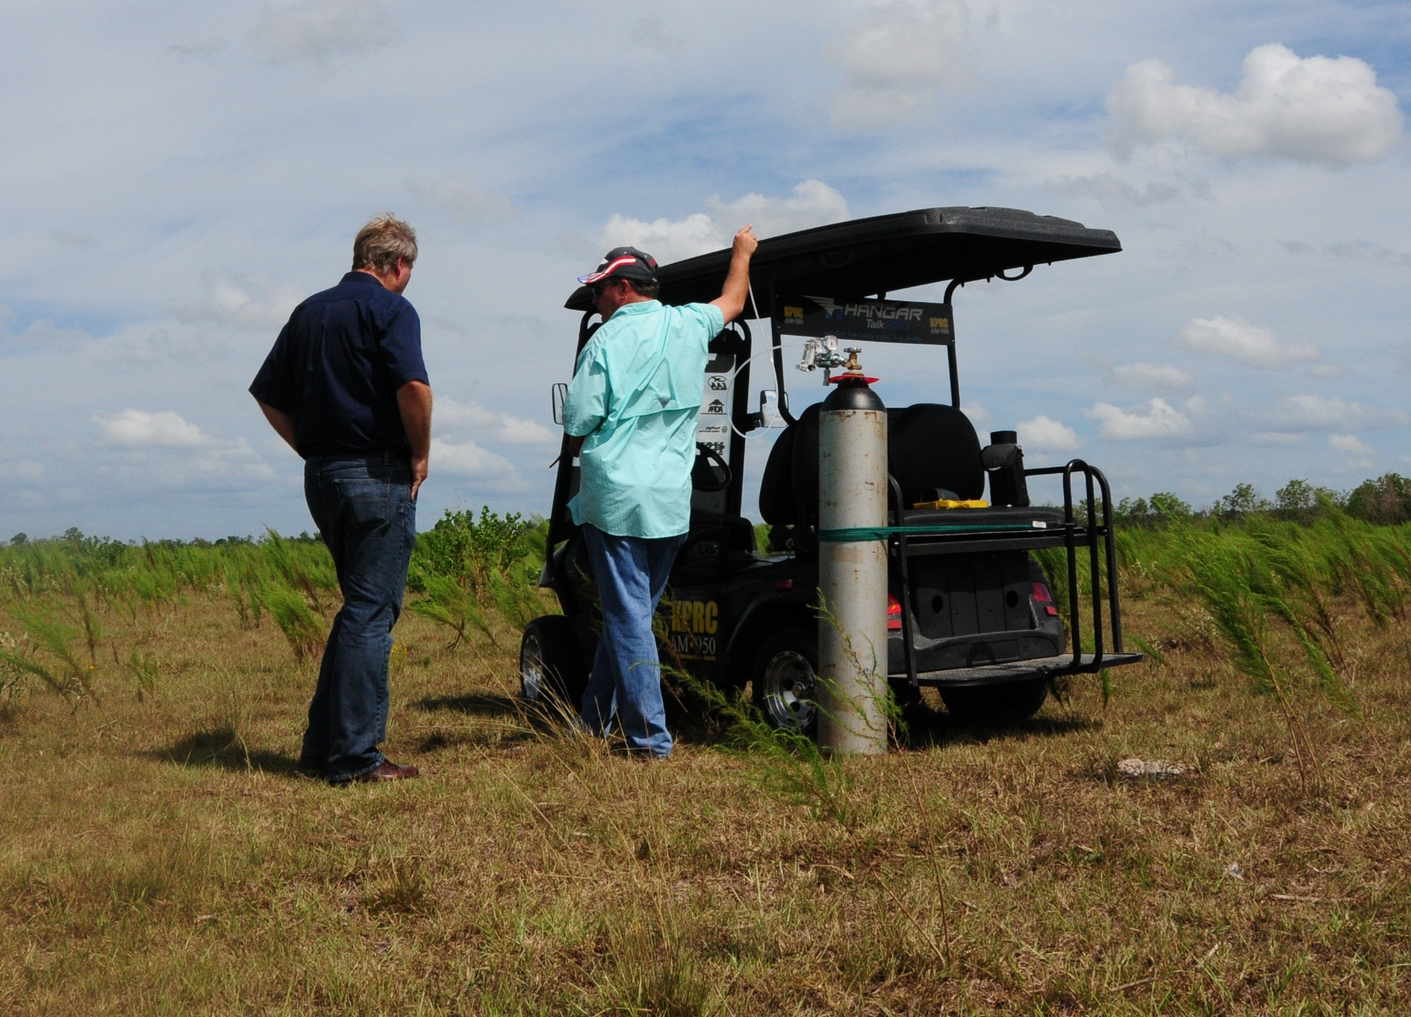
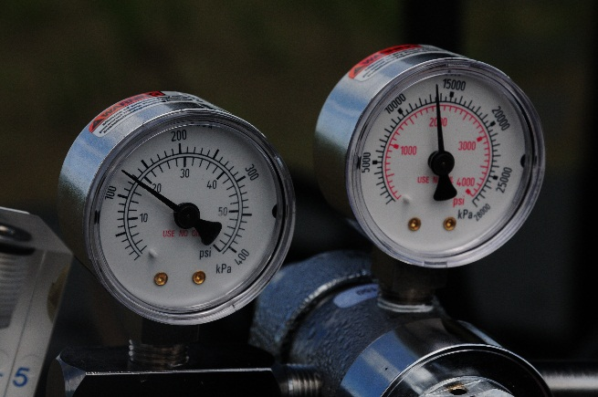
Factors to Consider
Safety = Job ONE
Sensitivity = Concentration + Environment
Type of pipeline = Gathering/ Distribution Vs. Transmission
Reliable Results = Engineered Solution
Report Management Reliability
Incident Support

Slide 27
Helicopter services?
Bob spradlin

Slide 28
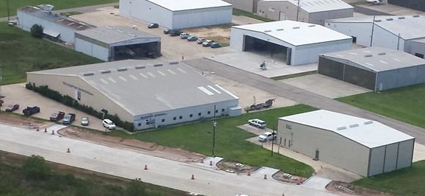
Helicopter Services Company- Overview

Slide 29
Helicopter Services
Company Overview
Owned by Russell D. Gordy, Houston Businessman
President, S.G. Interests a Texas Independent Oil and Gas company
Based at Hooks Airport, Spring, TX
Established 1980. Oldest and largest helicopter operator in Houston.
Hold FAA 135 Air Carrier Certificate HLXA728E
Certified FAA 145 Repair Station
Utilize Eurocopter A-Stars, Bell Jet Ranger and Robinson R-44 Raven aircraft for charter.
Full time flight school using Schweizer 300 and Robinson R-44/R-22 helicopters
Robinson Helicopters Authorized Sales, Service and Component Overhaul Center
Rolls-Royce R-300 Engine Service Center

Slide 30
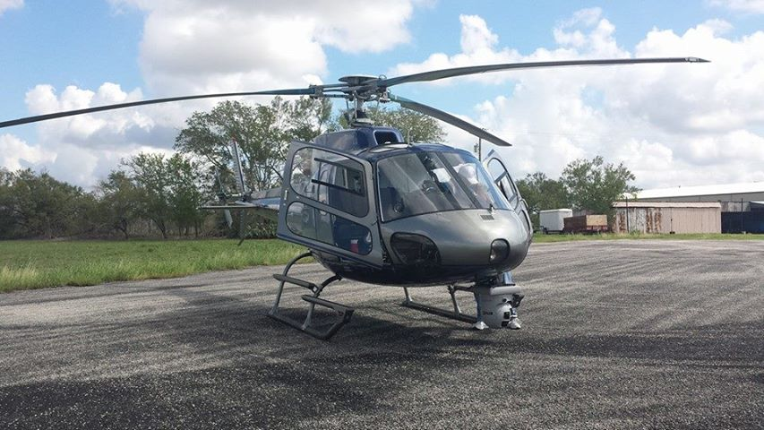
Operational Experience
SPT Offshore - LNG Platform
Entergy : - Power Line Patrol
Enterprise (EPCO): - Pipeline Patrol
TEPPCO: - Pipeline Patrol
Centerpoint Energy: - Power Line Patrol
TARGA Pipeline: - Pipeline Patrol
AT&T - Tower Inspection
Energy Quest - Pipeline Patrol
American Trigger Sports Network - Aerial Photography
SAM - Aerial Lidar

Slide 31
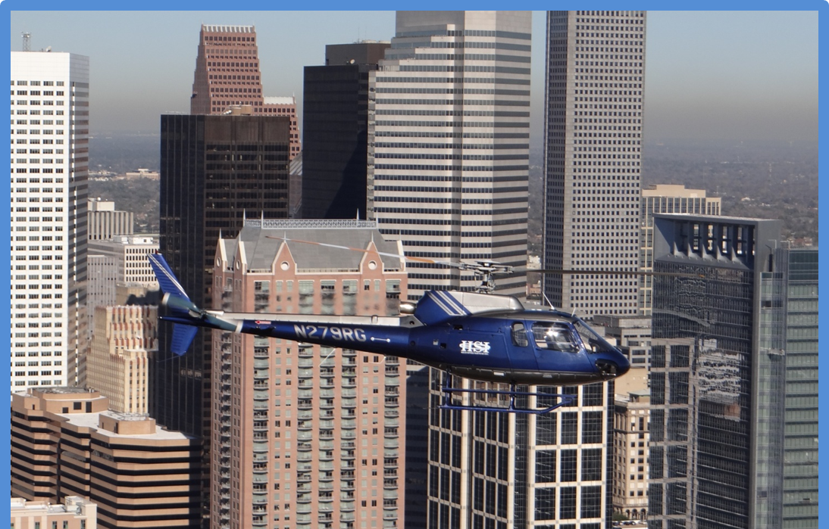
Aircraft – Eurocopter AS 350 A-Star

Slide 32


Bell BH-206 Jet Ranger

Slide 33
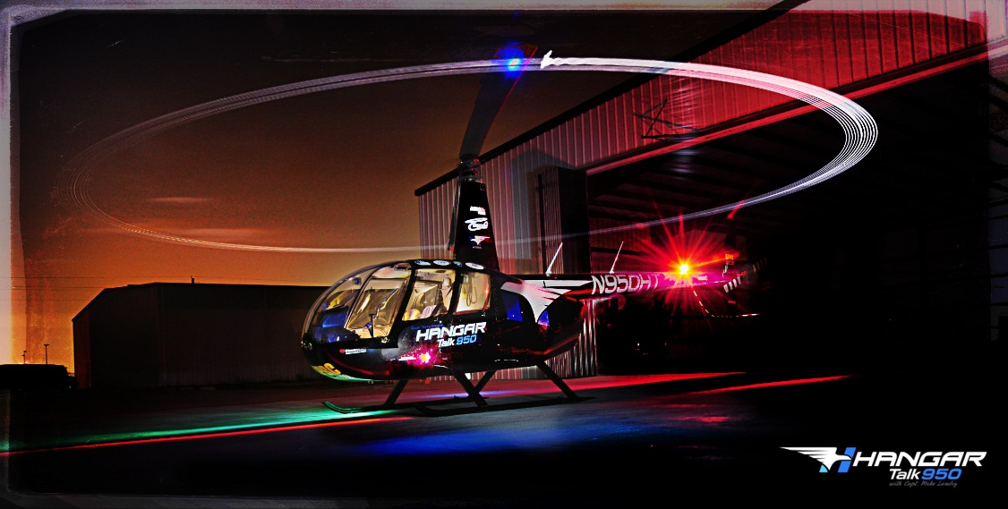
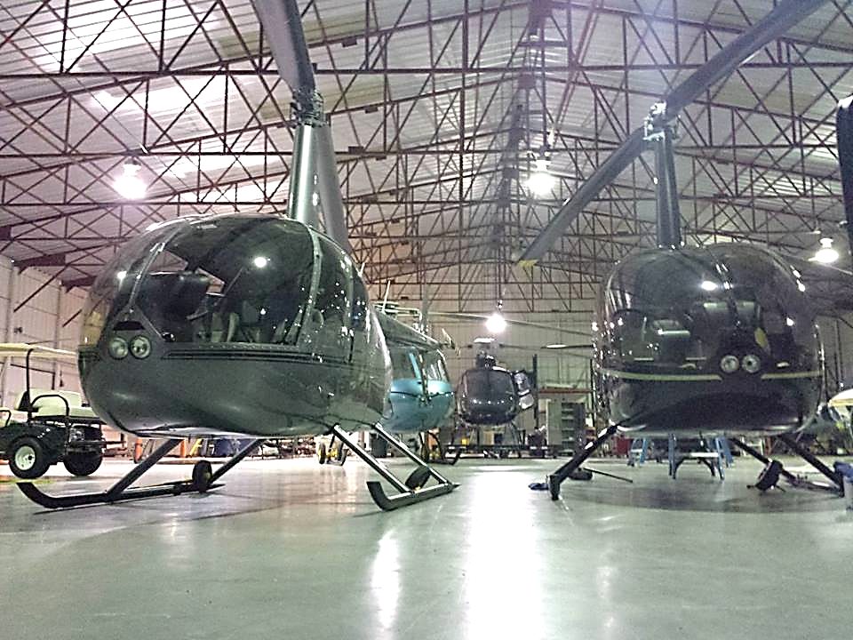
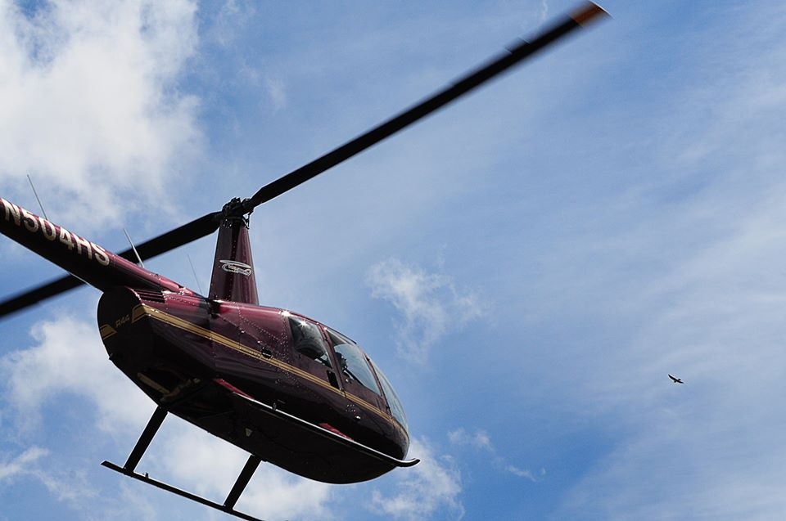
R-44 Raven

Slide 34
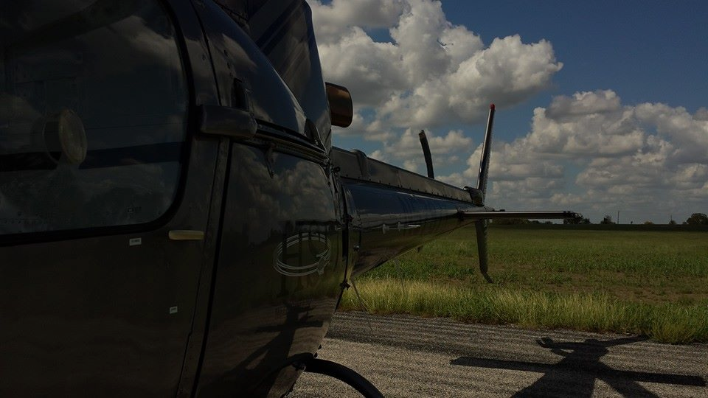

Company Safety Commitment

Slide 35

Company Safety Commitment
Safety First – We know that you don’t compromise safety - we will not compromise safety either.
Company Safety Management System (SMS) is strictly adhered to by all employees.
SMS is part of FAA Initial/Recurrent training program.
Three year history OSHA Record Incident Rate = 2.29
Three year history Interstate Workers Comp. E.M.R = 0.92

Slide 36

Flight Following
Flight following is done in house and manned at all times during all flight operations.
Aircraft are equipped with the “Blue Sky” Satellite GPS system for continuous tracking of aircraft.

Slide 37

Summary
Engineered Solutions
DOT Procedures
DOT Training
Mechanical Integrity Management Program (IMP)

Slide 38

Questions?

